Slide 1
Unit 2
STATIONARY TIME SERIES MODELS
Wold representation of linear stationary processes, Study of linear time series models: Autoregressive, Moving Average and Autoregressive Moving average models and their statistical properties like ACF and PACF function.

Slide 2
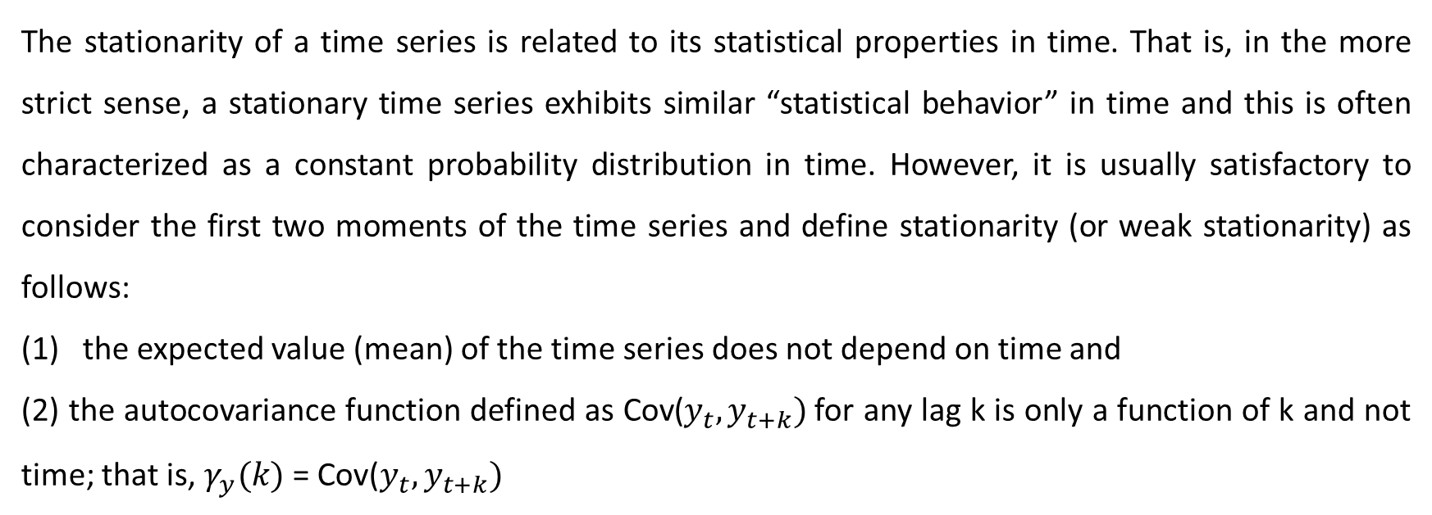
Stationary Time series
The stationarity of a time series is related to its statistical properties in time. That is, in the more strict sense, a stationary time series exhibits similar “statistical behavior” in time and this is often characterized as a constant probability distribution in time. However, it is usually satisfactory to consider the first two moments of the time series and define stationarity (or weak stationarity) as follows:
the expected value (mean) of the time series does not depend on time and
(2) the autocovariance function defined as Cov($y_{t},y_{t+k})$for any lag k is only a function of k and not time; that is, $γ_{y}(k)$ = Cov($y_{t},y_{t+k})$

Slide 3
Stationary Time series
In a crude way, the stationarity of a time series can be determined by taking arbitrary “snapshots” of the process at different points in time and observing the general behavior of the time series. If it exhibits “similar” behavior, one can then proceed with the modeling efforts under the assumption of stationarity.
Further preliminary tests also involve observing the behavior of the autocorrelation function. A strong and slowly dying ACF will also suggest deviations from stationarity

Slide 4
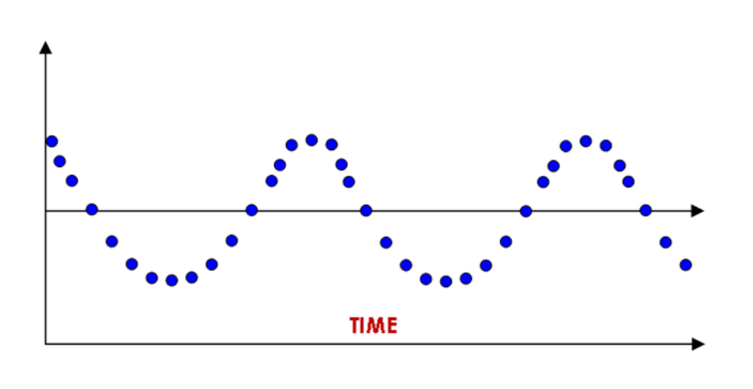
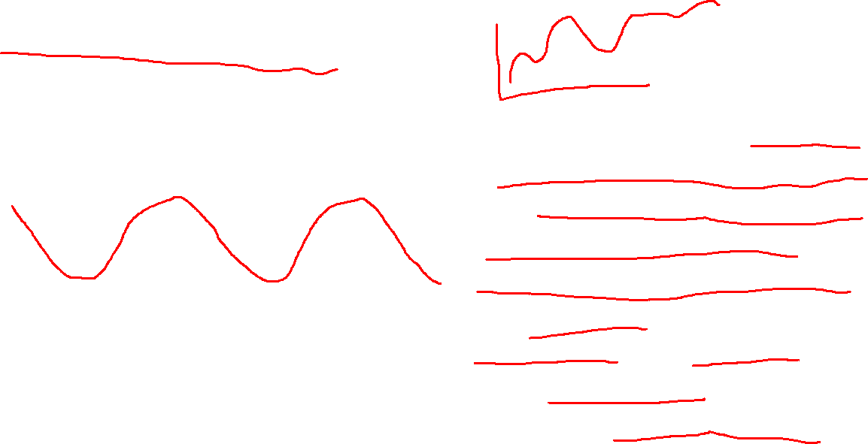
Stationary Time series
A stochastic process is said to be stationary if its mean and variance are constant over time and the value of the covariance be-tween the two time periods depends only on the distance or gap or lag between the two time periods and not the actual time at which the covariance is computed. Such a time series will tend to return to its mean (called mean reversion) and fluctuations around this mean (measured by its variance) will have a broadly constant amplitude.

Slide 5
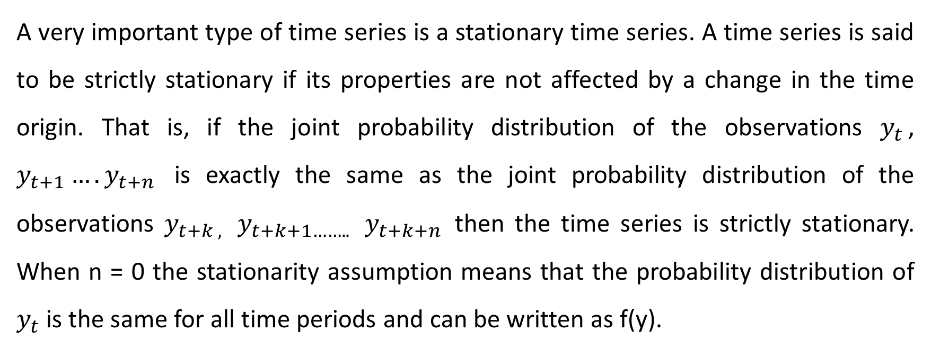
Stationary time series
A very important type of time series is a stationary time series. A time series is said to be strictly stationary if its properties are not affected by a change in the time origin. That is, if the joint probability distribution of the observations $y_{t}$, $y_{t+1}….y_{t+n }$is exactly the same as the joint probability distribution of the observations $y_{t+k , }$ $y_{t+k+1…….. }$ $y_{t+k+n }$then the time series is strictly stationary. When n = 0 the stationarity assumption means that the probability distribution of $y_{t}$is the same for all time periods and can be written as f(y).

Slide 6
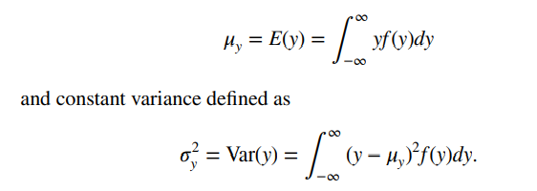
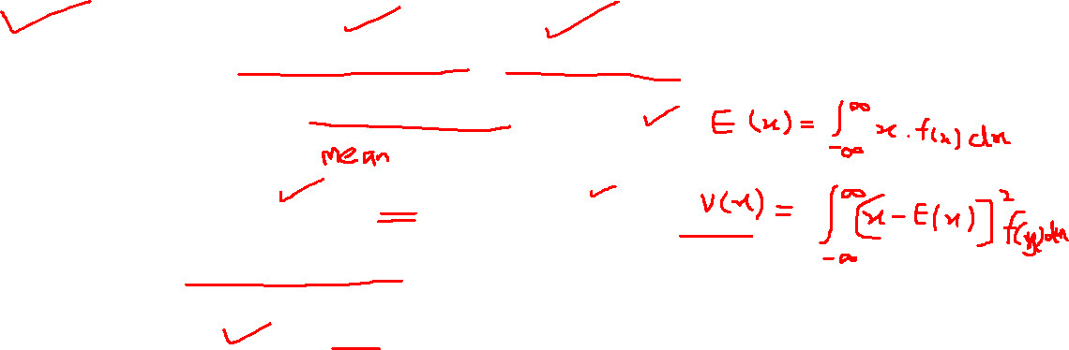
Stationary Time series
Stationary implies a type of statistical equilibrium or stability in the data. Consequently, the time series has a constant mean defined in the usual way as

Slide 7
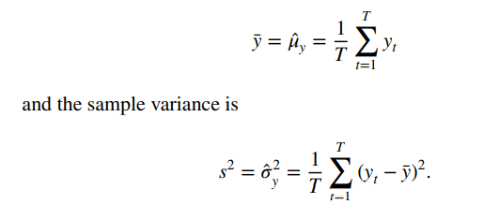
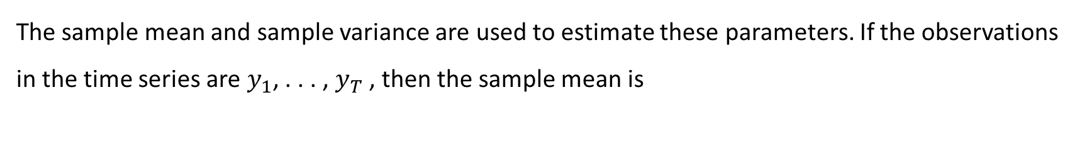
Stationary Time series
The sample mean and sample variance are used to estimate these parameters. If the observations in the time series are $y_{1}$, . . . , $y_{T}$ , then the sample mean is

Slide 8
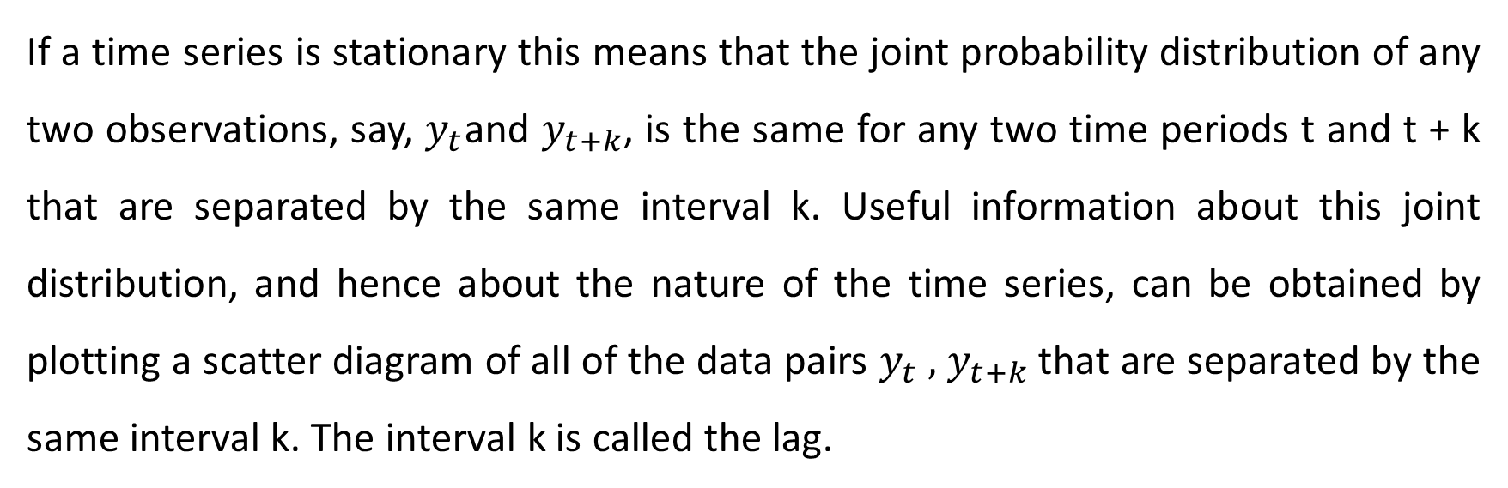
Autocovariance and Autocorrelation Functions
If a time series is stationary this means that the joint probability distribution of any two observations, say, $y_{t}$and $y_{t+k}$, is the same for any two time periods t and t + k that are separated by the same interval k. Useful information about this joint distribution, and hence about the nature of the time series, can be obtained by plotting a scatter diagram of all of the data pairs $y_{t} ,$ $y_{t+k}$that are separated by the same interval k. The interval k is called the lag.

Slide 9
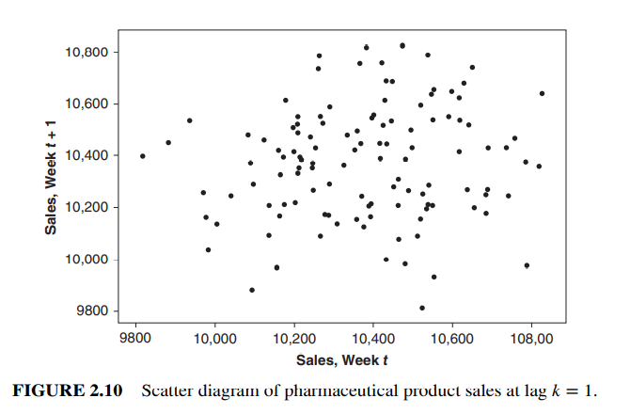
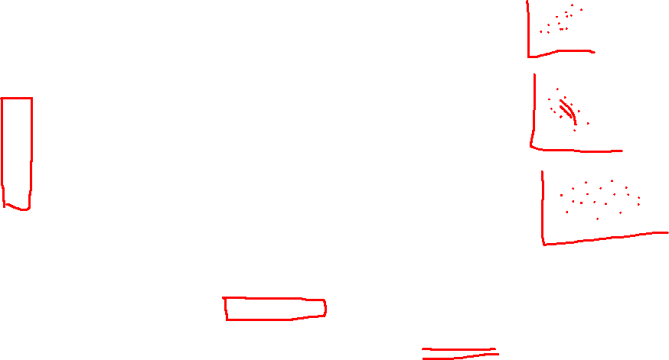
Autocovariance and Autocorrelation Functions

Slide 10
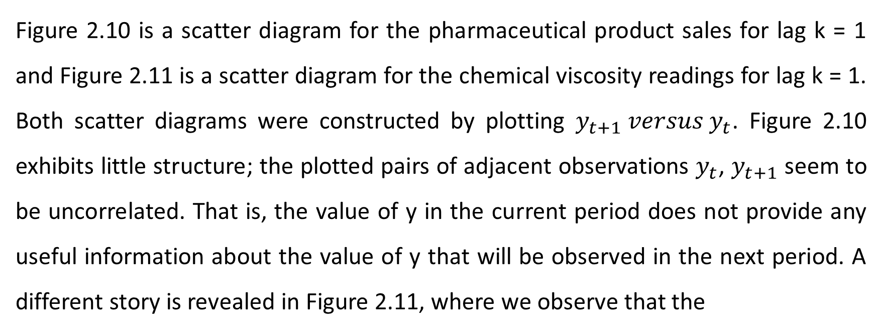
Autocovariance and Autocorrelation Functions
Figure 2.10 is a scatter diagram for the pharmaceutical product sales for lag k = 1 and Figure 2.11 is a scatter diagram for the chemical viscosity readings for lag k = 1. Both scatter diagrams were constructed by plotting $y_{t+1} versus y_{t}$. Figure 2.10 exhibits little structure; the plotted pairs of adjacent observations $y_{t}$, $y_{t+1}$ seem to be uncorrelated. That is, the value of y in the current period does not provide any useful information about the value of y that will be observed in the next period. A different story is revealed in Figure 2.11, where we observe that the

Slide 11
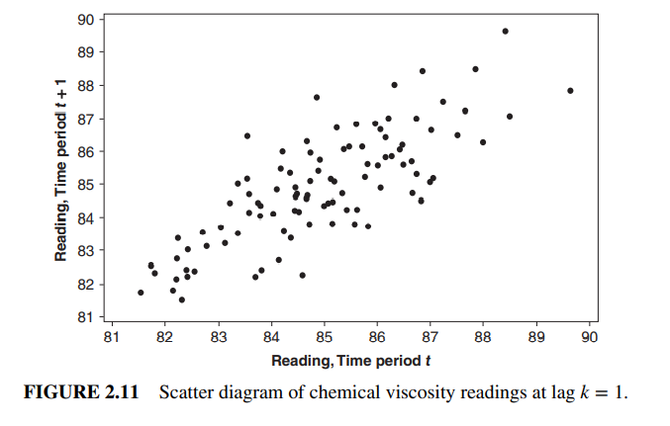
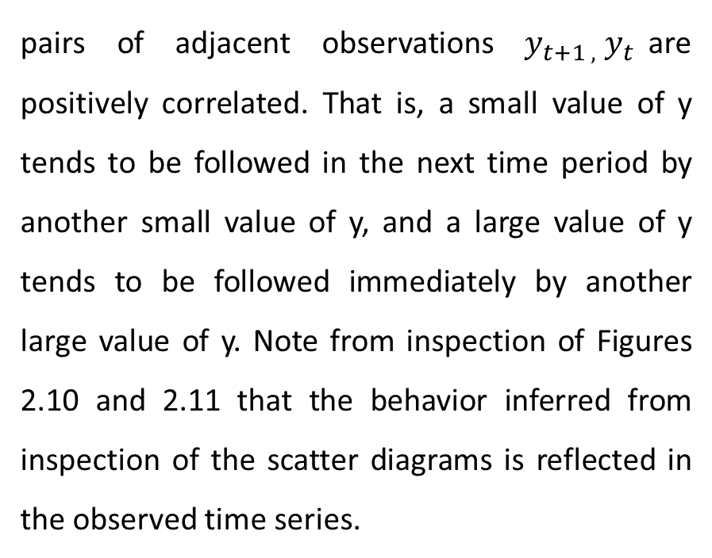
Autocovariance and Autocorrelation Functions
pairs of adjacent observations $y_{t+1 ,}{ y}_{t}$are positively correlated. That is, a small value of y tends to be followed in the next time period by another small value of y, and a large value of y tends to be followed immediately by another large value of y. Note from inspection of Figures 2.10 and 2.11 that the behavior inferred from inspection of the scatter diagrams is reflected in the observed time series.

Slide 12
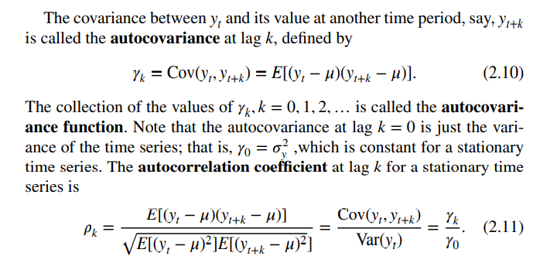
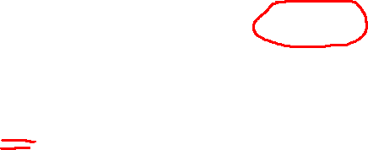
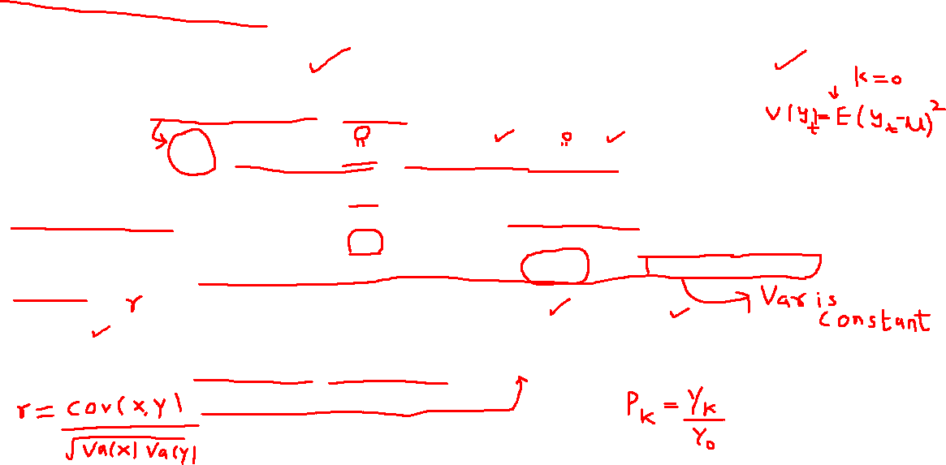
Autocovariance and Autocorrelation Functions

Slide 13
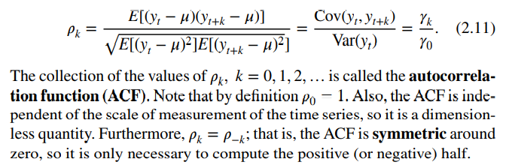
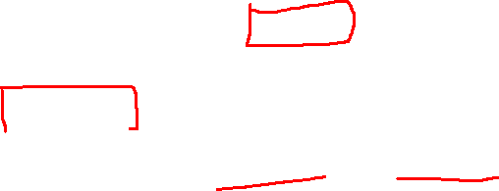
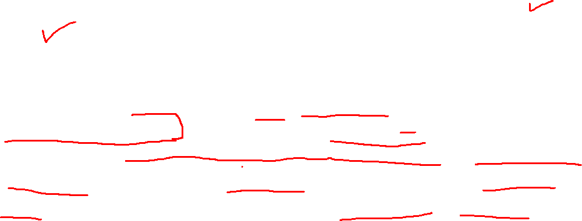
Autocovariance and Autocorrelation Functions

Slide 14
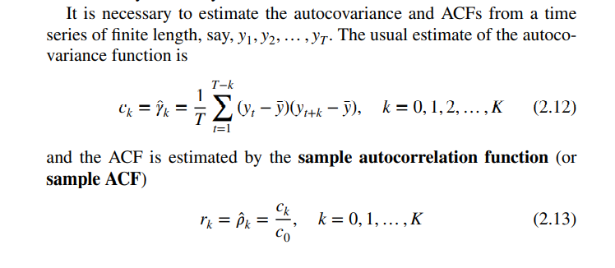
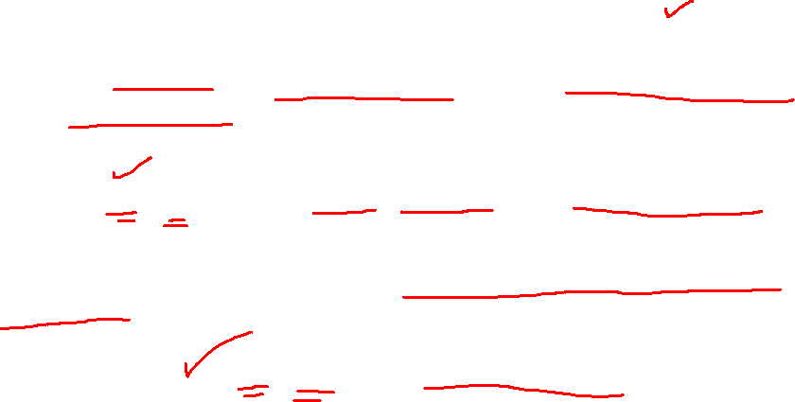
Autocovariance and Autocorrelation Functions

Slide 15
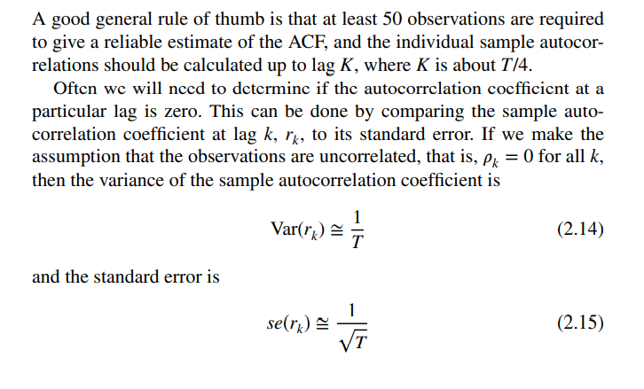
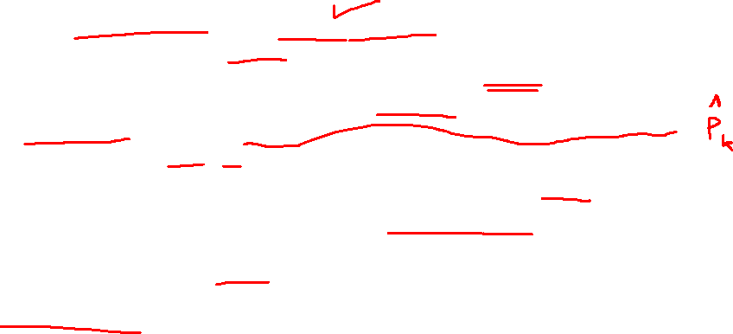
Autocovariance and Autocorrelation Functions

Slide 16
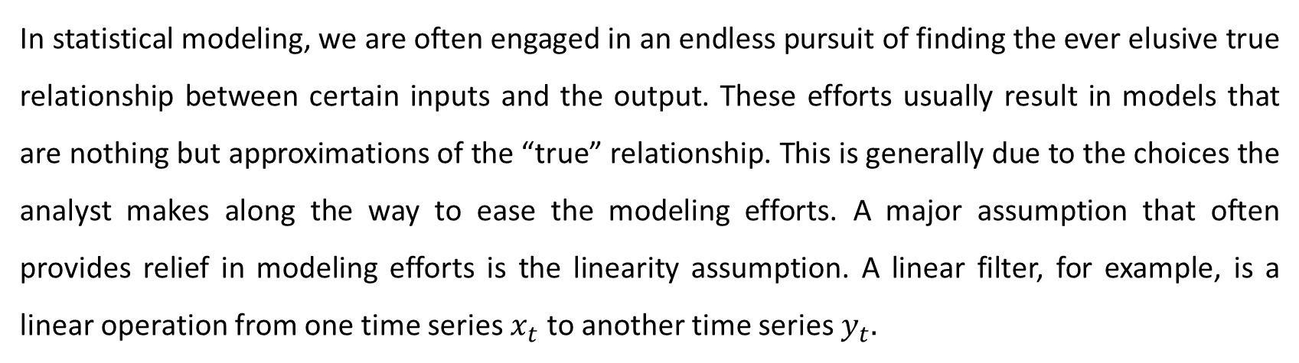
LINEAR MODELS FOR STATIONARY TIME SERIES
In statistical modeling, we are often engaged in an endless pursuit of finding the ever elusive true relationship between certain inputs and the output. These efforts usually result in models that are nothing but approximations of the “true” relationship. This is generally due to the choices the analyst makes along the way to ease the modeling efforts. A major assumption that often provides relief in modeling efforts is the linearity assumption. A linear filter, for example, is a linear operation from one time series $x_{t}$ to another time series $y_{t}.$

Slide 17
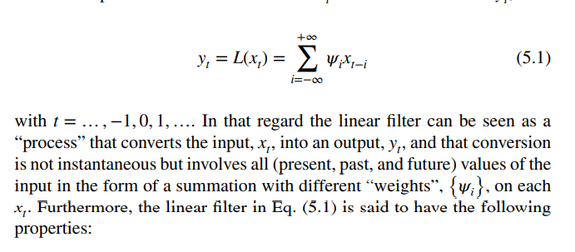
LINEAR MODELS FOR STATIONARY TIME SERIES

Slide 18
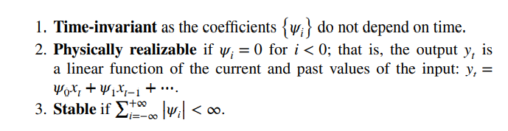
LINEAR MODELS FOR STATIONARY TIME SERIES
In linear filters, under certain conditions, some properties such as stationarity of the input time series are also reflected in the output.

